Slide 1
CSM Scrolling
An acceleration technique for the rendering of cascaded shadow maps

Slide 2
CSM Scrolling by: Mike Day mday@insomniacgames.com CSM Caching by: Al Hastings afh@insomniacgames.com Who am I? Mike Acton macton@insomniacgames.com

Slide 3
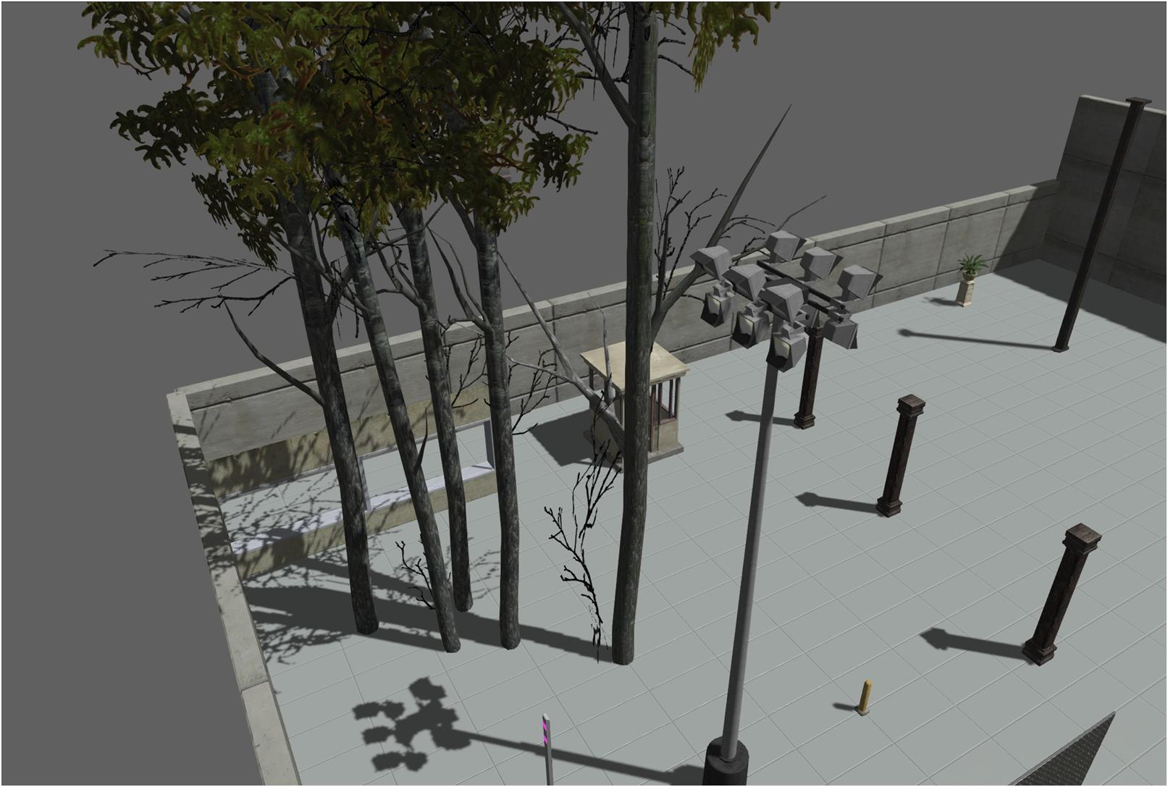
Quick Background

Slide 4
From light POV, imagine whole world as single mega shadow texture

Slide 5
On any particular frame, a shadow map represents a 2D rectangular slice of that volume.

Slide 6
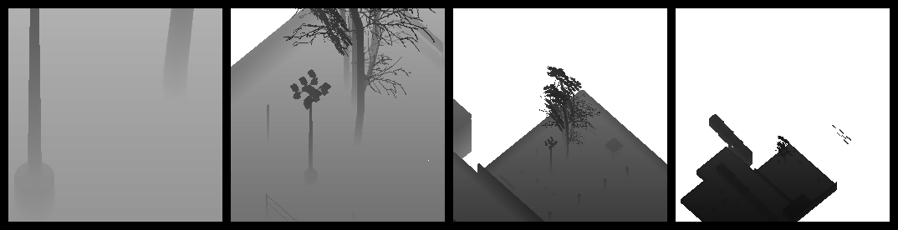
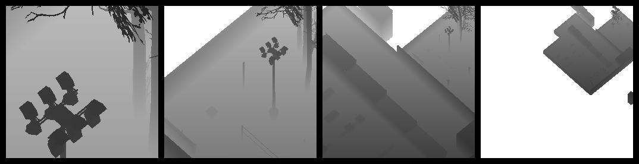
Cascade refers to multiple resolutions of that slice

Slide 7
Assumptions

Slide 8
Most of the time, the camera does not make radical changes across frames

Slide 9
Most geometry is relatively static across frames

Slide 10
Geometry which has changed from the previous frame can be identified

Slide 11
The light direction is relatively stable across frames

Slide 12
Results of spatial queries can be used in the same frame as shadow rendering

Slide 13
Geometry is divided into small* instances

Slide 14
Concept

Slide 15
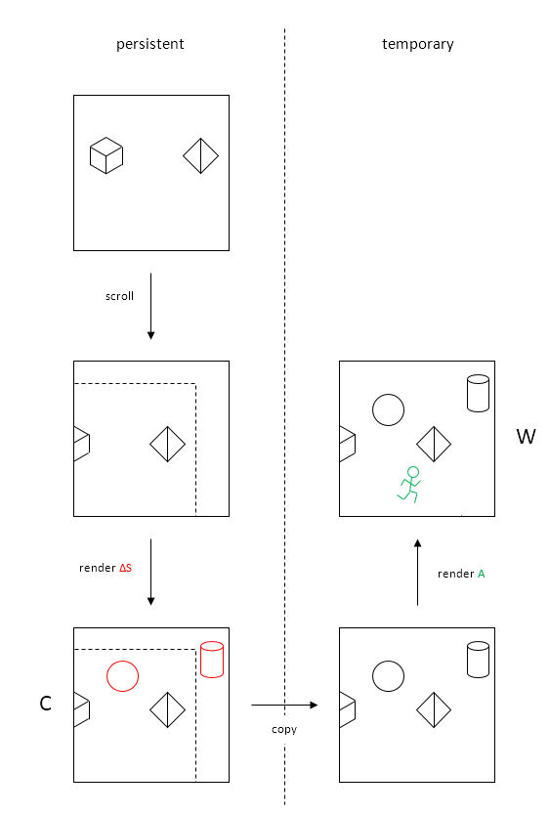
Store “static” geometry from previous frame in cached map

Slide 16
Scroll cached map to account for change in camera view

Slide 17
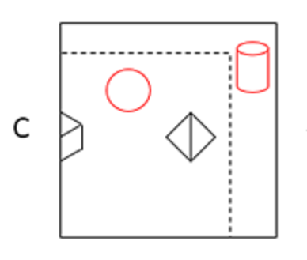
Render additional “static” geometry into edges exposed by scrolling

Slide 18
Render newly “static” geometry in cached area

Slide 19
Copy map to use as final shadow map for current frame

Slide 20
Render non-static geometry into final shadow map for frame

Slide 21
CSM Caching

Slide 22
Assumption: Camera is not moving (much)

Slide 23
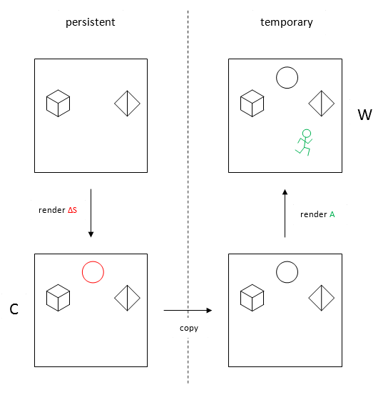
Store “static” geometry from previous frame in cached map

Slide 24
Store “static” geometry from previous frame in cached map
“static” = not moved for t time. (e.g. 5 seconds)

Slide 25
Each frame, render non-static geometry on to cached copy

Slide 26
Cache of previous frame shadow map

Slide 27
Cache of previous frame shadow map
Invalid if…

Slide 28
Cache of previous frame shadow map
Invalid if…
Camera moves
Camera FOV changes

Slide 29
Cache of previous frame shadow map
Invalid if…
Camera moves
Camera FOV changes
“Static” geometry moves

Slide 30
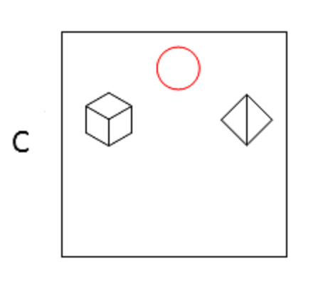
Render newly “static” geometry in cached area

Slide 31
Query for state of “static” geometry

Slide 32
Diff current “static” versus previous “static” query results

Slide 33
Dynamic occlusion system used

Slide 34
Create copy new map cache to use this frame

Slide 35
“Dynamic” geometry rendered to temporary shadow map

Slide 36
CSM Scrolling

Slide 37
Assumption: Camera moves a lot (but slowly*)

Slide 38
Insert in to CSM Caching:
Scroll map
Render into exposed edges

Slide 39
Scroll cached map to account for change in camera view

Slide 40
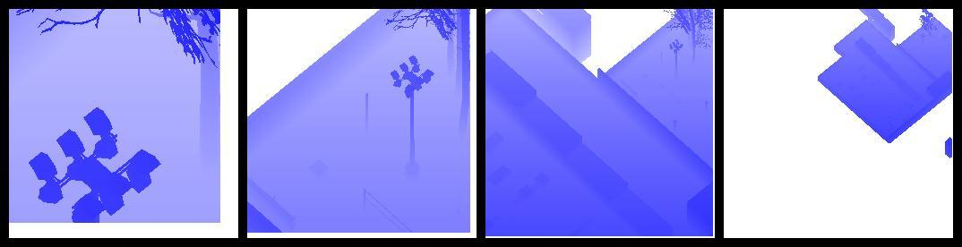

Sample shadow texels from previous frame

Slide 41
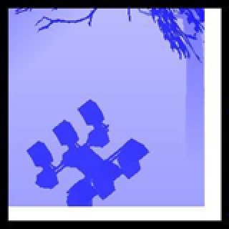
Scrolled area is clamp-to-border (color=1.0)

Slide 42
Observe:
Camera motion is 3D

Slide 43
Observe:
Camera motion is 3D
Lateral scrolling
Depth scrolling

Slide 44
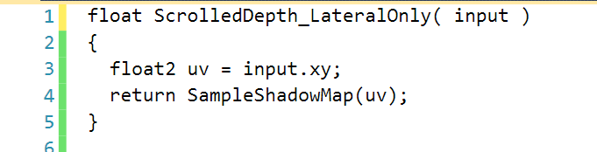
Lateral scrolling
Translation perpendicular to light rays
UV translated by delta camera in light frame

Slide 45
Lateral scrolling
Translation perpendicular to light rays
Simple texture lookup
(Point sampling)

Slide 46
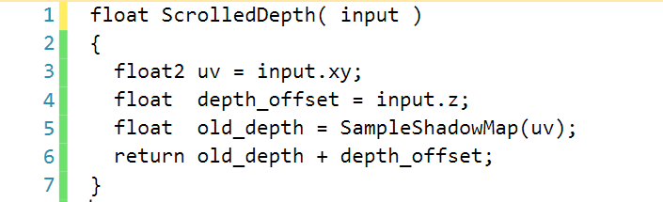
Depth scrolling
Translation parallel to light rays
Additional handling needed for depth scroll

Slide 47
Depth scrolling
Translation parallel to light rays
Delta camera depth in light frame

Slide 48
Depth scrolling
Translation parallel to light rays
Offset all previous depths
(scroll depth)

Slide 49
Depth scrolling
Translation parallel to light rays
Gotchas:
Near plane
Far plane

Slide 50
Depth scrolling
Translation parallel to light rays
Gotchas:
Near plane
Far plane
Clamp to 0.0

Slide 51
Depth scrolling
Translation parallel to light rays
Gotchas:
Near plane
Far plane
Problem 1.0 = buffer clear

Slide 52
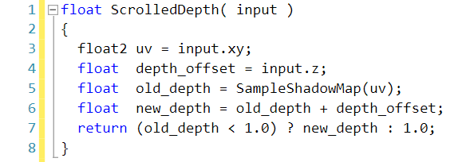
Depth scrolling
Translation parallel to light rays
Gotchas:
Near plane
Far plane
Problem 1.0 = buffer clear
No offset

Slide 53
Render additional “static” geometry into edges exposed by scrolling

Slide 54

Scrolled in area divided into slabs (thin OBBs)

Slide 55
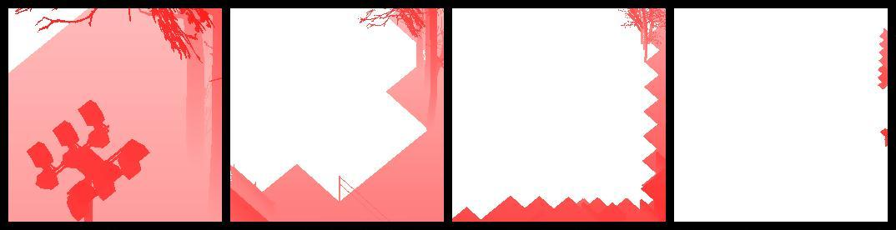
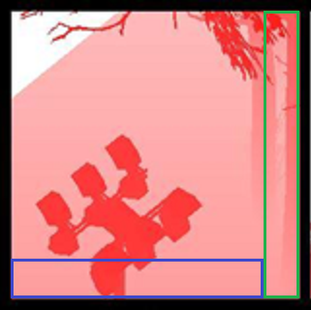
‘Static’ geom with overlapping bounding volume rendered

Slide 56
Observe: Coarseness of geometry relative to view

Slide 57
Lots of overlapping volumes

Slide 58
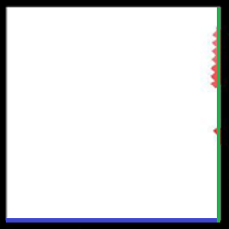
Very few overlapping volumes

Slide 59

(Aside)
Jagged pattern not relevant: Using square geom tiles

Slide 60
Render newly “static” geometry in cached area

Slide 61
Copy map to use as final shadow map for current frame

Slide 62
CSM Scrolling

Slide 63
Each map (512x512) PS3/360

Slide 64
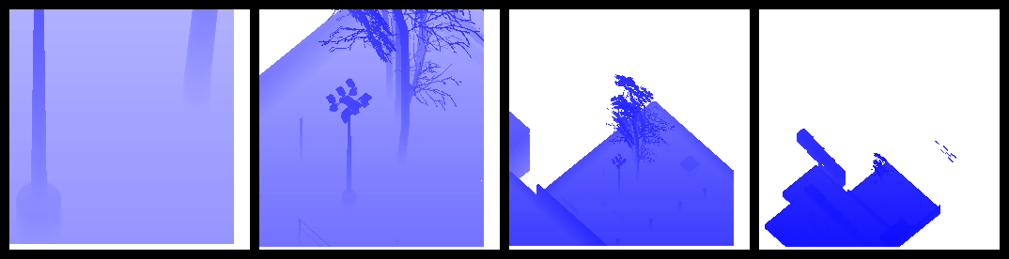

Another view…

Slide 65
Wrap up

Slide 66
Straightforward addition to CSM Caching

Slide 67
Key: Like 2D bitmap scrolling

Slide 68
Do not render ~70% of ‘static’ geometry in to CSM

Slide 69

Detailed paper:
bit.ly/QIoBr9

